Slide 1
Variables and operators

Slide 2
Learning objectives
Data types, constants and Variables
Scalars and list variables
Naming conventions
Scopes
Operators
String opertors
Mathematical operators
Binary operators
Urinary operators
Operators on scalars and lists

Slide 3

Constants and variables
Calculate simple interest (I)
We need to input
Principal amount (p), rate of interest (r) and time in years (t)

Slide 4
Constants and variables
Calculate simple interest (I)
We need to input
Principal amount (p), rate of interest (r) and time in years (t)
variables
constant

Slide 5
Constants and variables
Calculate simple interest (I)
We need to input
Principal amount (p), rate of interest (r) and time in years (t)
Variables are used to store data
Contanst values can not be changed
Literals
Memory (RAM)
variables
p
constant
r
t
I

Slide 6
Data types
Integers
8 14 10000 200000
Floats
0.001 0.2 23.45 1e-10
String
“John” “Brazil” “attgacagat” ‘mmklysvy’
Boolean
0 1

Slide 7
Variables in Perl
Variable – a name for a block in computer memory holding some data
Perl variables are not data type specific
No need to pre-declare variables
All variables are in Global score (by default)
Three types of variables
Scalar
Array
Hash

Slide 8
Scalar variables
Can store only one element
It is represented by a Dollar ($) symbol
$a
$student_name
$phone_no
Assign value to a scalar
$a =10;
$student_name = “kanhu”;
$ phone_no = 9876543001;

Slide 9
Variable naming conventions
Variable names can contain letters, numbers and underscores
Case sensitive
Cannot start from number (digit)

Slide 10
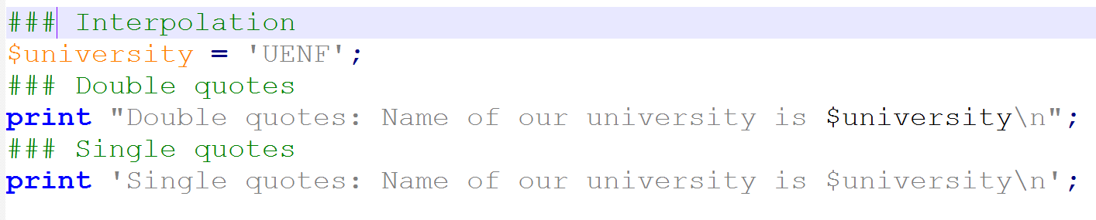
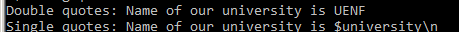
Variable interpolation
With in double quoted strings Perl substitutes a variable with its stored value.
This is not allowed within single quoted strings.

Slide 11
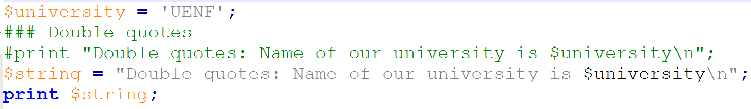

Variable within another variable

Slide 12
Operators
Elements that operates on data called operators.
E.g : 1 + 4 , + is an operator
Arithmetic operators manipulate on numeric scalar data.
Assignment operators are used to assign data to a scalar or list.
Comparison operators are used to compare two pieces of scalar data.
Logical operators can be used to do some Boolean logic calculations.
String manipulation operators manipulate on strings.

Slide 13
Arithmetic operators
$variable1 = 1000000 + 222;
$variable1 = 1000000 * 222;
$variable1 = 1000000 - 222;
$variable1 = 1000000 / 222;
$variable1 = 121**3; # power =1771561 or ^
$variable1 = 1000000 % 222; # modulus, =112
$variable1++ ; # increase value by 1
$variable1-- ; # decrease value by 1

Slide 14
Assignment operators
Operators | Examples
= (assign) | $a =$b + $c; means add $b + $c and assign to $a
+= (add and assign) | $a+=$b; means $a = $a+$b;
*= (multiply and asign) | $a*=$b; means $a = $a*$b;
-= (subtract and assign) | $a-=$b; means $a = $a-$b;
.= (concatenate and assign ) | $a.=$b; means $a = $a.$b;

Slide 15
Comparison operators
Operators | Numerical | String
Is equal | == | eq
Not equal | != | ne
Greater than | > | gt
Les than | < | lt
Greater than equal | >= | ge
Les than equal | <= | le
General comparison | <=> | cmp

Slide 16
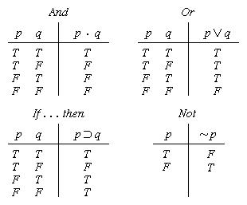
Logical operators
&& OR and : logical AND
|| OR or : logical OR
! : NOT

Slide 17
String manipulation operators
x
String repetition operator
.
String concatenation operator

Slide 18
Other operators
..
Range operator (0..10)

Slide 20
Exercise

